Slide 1
State chart Diagram

Slide 2
A state diagram is used to represent the condition of the system at finite instances of time.
It’s a behavioral diagram and it represents the behavior using finite state transitions.
State diagrams are also referred to as State machines and State-chart Diagrams.

Slide 3
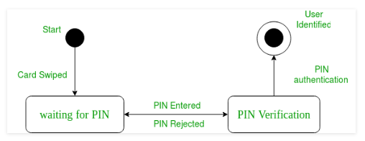

Slide 4
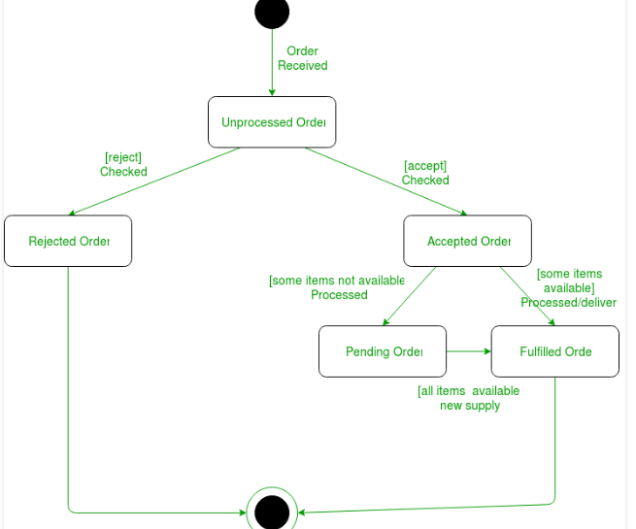
Online Order

